Slide 1



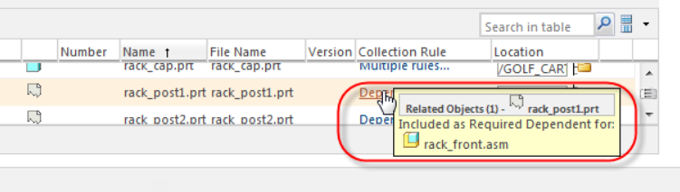
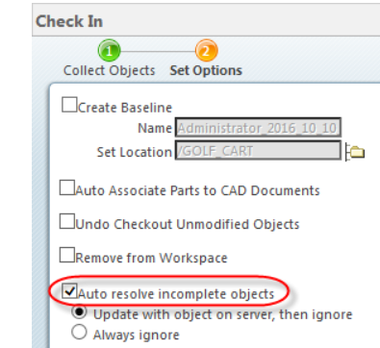
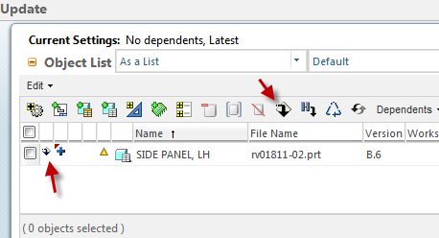
How to Remove a ghost
1
If there is a parent/child dependency to an object that is not in session or available during import to workspace, Creo will create an incomplete/ghost object in the active Workspace during #File > #Save or #Tools > #Import to Workspace. Incomplete objects are the direct result of Creo models having references to other models and where the referenced model is not available to be saved to the workspace. For example:
Assembly files that contain suppressed components.
Substituted components, replaced components, skeletons.
Assemblies that reference an interchange assembly.
Models that contain merge/cut out features, inheritance features or copy geometry.
External copy geometry.
Pro/Program models.
Layouts and drawings that reference historic models or features.
Nested family table generics.
Models opened as simplified representations and saved to the workspace where components are not in session.
Reference that have been renamed and where the object hasn't been updated.
2
b.
c.
Tool Tips
Resolution
Instead of using the …
Mouse over the Collection Rule for the incomplete object in the check in dialog will show if the object is a required or optional dependent
CAUTION: Required Dependents MUST be resolved prior to Check In
•Optional Dependents can be resolved prior to Check In or Ignored on Check In
1
If the incomplete object exists on the server, selecting to update (a) with the same object on the server can automatically resolve the object. You can also use the update (b) tool in the workspace to replace the ghost by the server object.
a
b
g
2
CAUTION: Using the update tool, select the download option

Slide 2
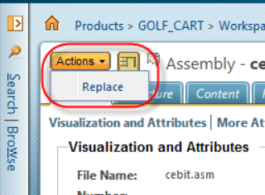
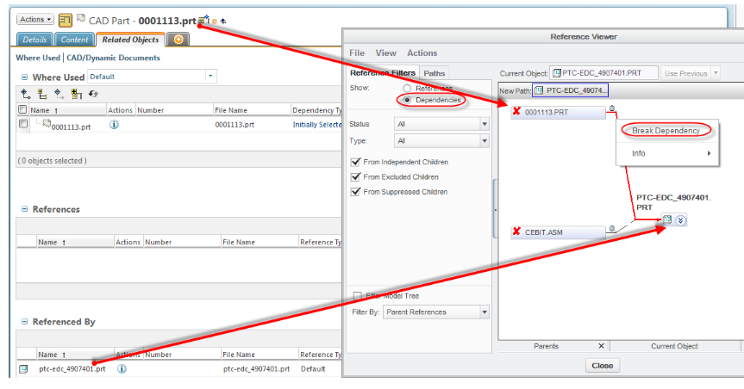
The ghost can be replaced with another object from the server via the workspace details page Replace action
1
2
b.
c.
3
The incomplete object can be resolved via the workspace details page Add action.
Find the incomplete object on the filesystem, open in session and save to workspace or import it.
In some cases, use these config options cleanup_drawing_dependencies and cleanup_layout_dependencies per article.
In some cases, one can use config option dm_hide_model_dummy_deps per article 28858.
Or you can try to break the dependency in Creo via the Reference Viewer:
Tool Tips
Instead of using the …
4
g
If all the previous solutions did not works.
Try to update the model removing the feature or component that has the dependency to the incomplete object.
Or create a model with the same name as the incomplete object (in a non-linked session) and open in session and save to the workspace or import into the workspace in a linked session.
Still not resolve go to point 6
5

Slide 3
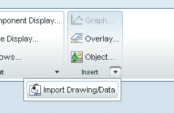
1- Prior to do this, valid that you well cleaned "models drawing“.
2- If the item is not in the models drawings.
a. Open the part or Assembly of the drawing that has the link to a non related part or ghost.
b. Make a new drawing call it 123.drw.
c. In the Layout tab. Click insert import Drawing Data.
d. Choose the original drawing.
e. Delete page 1 of 123.drw drawing.
f. Make a backup of the new drawing on your local drive.
g. Rename the new drawing such as the original drawing on your local drive.
h. Close all items in Creo and erase not display.
i. Check-out of the original drawing. (do not open)
j. Open the new drawing and save, ok to accept to overwrite the version of the workspace
1
2
b.
c.
6
Tool Tips
Instead of using the …
g

